Slide 1
Parallel Image Processing
Mohammad Khan, Tung Pham, Johann Zhang
High Performance Computing - Final Project
12/04/24
Highlighting the importance of parallelization through image manipulation techniques

Slide 2
Introduction
Mohammad Khan, Tung Pham, Johann Zhang
High Performance Computing - Final Project
12/04/24
Processing of images can be a computational intensive task
Images can be broken up
Good setup for parallelization
Different processing techniques require different computational and mathematical functions
Need to be parallelized differently
Common to see bottlenecks in image and video parallelization tasks
Motivation: Image processing is common, mathematically fun, and scalability is relevant

Slide 3
Background
Mohammad Khan, Tung Pham, Johann Zhang
High Performance Computing - Final Project
12/04/24
Numpy, numerical computing package
Use Vectorization which leverage C for looping
Provide optimization mechanism with parallelism but no out of the box solution.
OpenCV, computer vision package
No parallelism option straight out of the box.

Slide 4
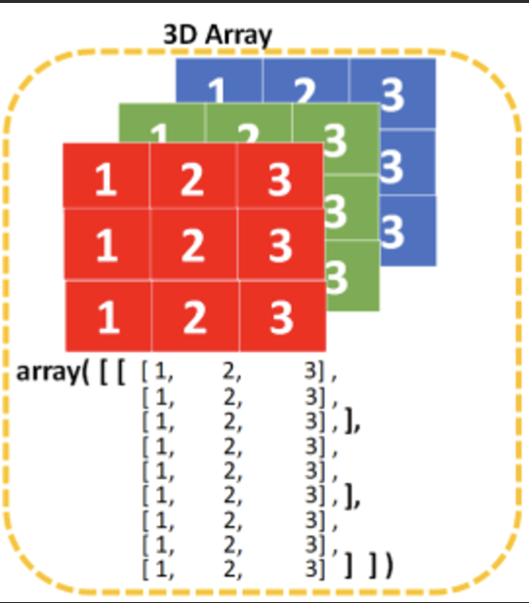
Our approach
Mohammad Khan, Tung Pham, Johann Zhang
High Performance Computing - Final Project
12/04/24
Use MPI for parallelize matrices operations.
Image samples taken from ImageNet dataset.
Provide different image transformations:
Basic Image transformations (rotation, color filters, etc)
Fourier Transform
Image Compression
Possible extensions:
Affine transformations
Color jittering

Slide 5
Base Algorithm
Mohammad Khan, Tung Pham, Johann Zhang
High Performance Computing - Final Project
12/04/24
func transform():
MPI_Init();
Divide the work by columns/rows/blocks (depending on the type of transformation)
Do transformation
Gather all the data from the threads to create the final image
MPI_Finalize();

Slide 6
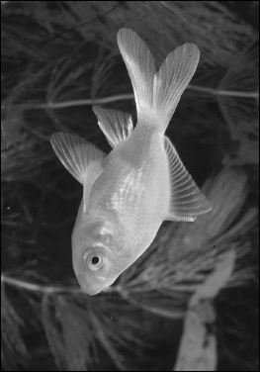
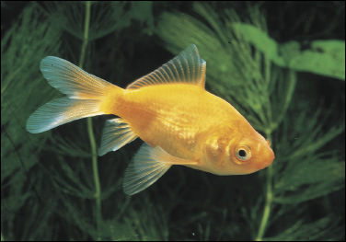
Current Progress
Mohammad Khan, Tung Pham, Johann Zhang
High Performance Computing - Final Project
12/04/24
Greyscale
Before
After

Slide 7
Current Progress
Mohammad Khan, Tung Pham, Johann Zhang
High Performance Computing - Final Project
12/04/24
Brightness adjustment:
Main process loads image
Broadcast image dimensions
Broadcast image data - each process assigned a block of rows
Perform adjustment by halving pixel values
Gather process blocks to main and combine
Save
Greyscale relies on OpenCV but can be done manually

Slide 8
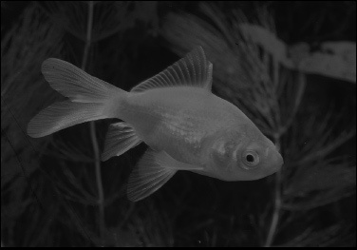
Current Progress
Mohammad Khan, Tung Pham, Johann Zhang
High Performance Computing - Final Project
12/04/24
Result:
Before
After

Slide 9
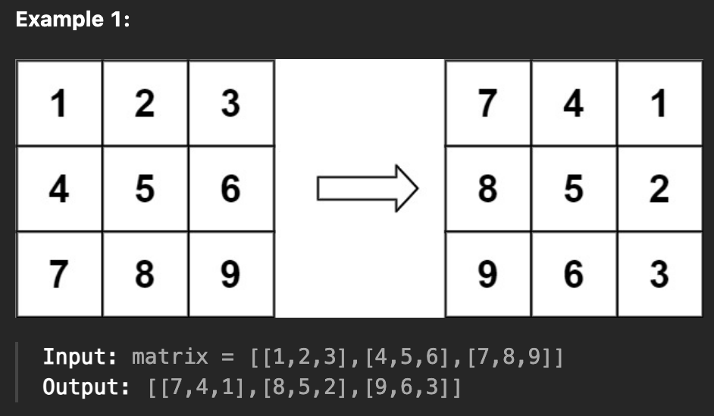
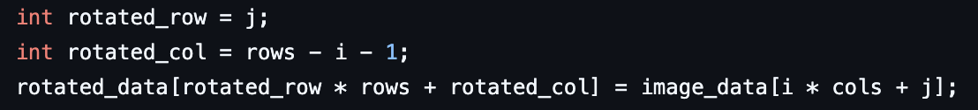
Current Progress
Mohammad Khan, Tung Pham, Johann Zhang
High Performance Computing - Final Project
12/04/24
Rotation
Map column to row
Map row to flipped column
Set pixel value

Slide 10
Current Progress
Mohammad Khan, Tung Pham, Johann Zhang
High Performance Computing - Final Project
12/04/24
After
Result:
Before

Slide 11
Evaluation + Continued work
Mohammad Khan, Tung Pham, Johann Zhang
High Performance Computing - Final Project
12/04/24
Weak scalability
Strong scalability - Different image resolutions
Compare benchmark with other computer vision libraries
Implement more image processing methods e.g parallel jpg compression
Explore different ways of work distribution to improve scalability
Compare with existing implementation e.g greyscale using NTSC formula

